Slide 1
Unit testing best practices and common pitfalls
By Nikolay Dermendzhiev

Slide 2
Agenda
Unit testing basics
Myths and reasons for not writing unit tests
Characteristics of a good unit test
Best practices for writing unit tests
Code coverage

Slide 3
Unit testing basics

Slide 4
What is a unit test
Unit tests are automated tests written and performed by software developers to ensure that a part of an application (called the “unit”) meets its specification and performs as expected.

Slide 5
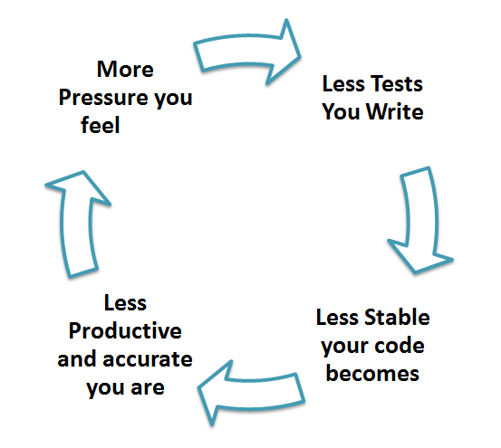
Why unit testing?
Fix bugs early in the development cycle and save costs
Protection against regression
Improve design, code and product quality

Slide 6
Unit testing in C# (toolset)
Unit testing frameworks: xUnit, NUnit, MSTest
Test double frameworks: FakeItEasy, Nsubstitute, Moq
Code Coverage: Default Visual Studio Code Coverage, ReSharper’s dotCover, Open Cover, NCover, NCrunch
Other: Fluent Assertions, Likeness, Nbuilder

Slide 7
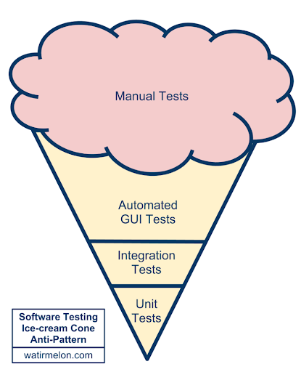
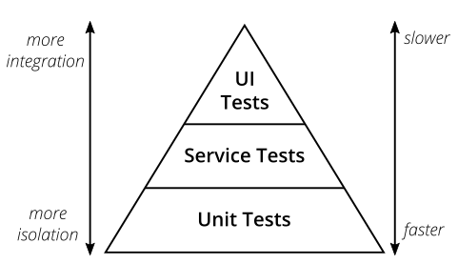
Test Pyramid

Slide 8
Myths and reasons for not writing unit tests

Slide 9
Myths and reasons for not writing unit tests
When developers do not trust the unit tests
It’s a legacy system, it’s too late to write any tests
Tests are making us slower
Business don’t give us the time to write tests

Slide 10
Characteristics of a good unit test
Trustworthy
Maintainable
Readable
Fast
Isolated
Repeatable

Slide 11
Best practices

Slide 12
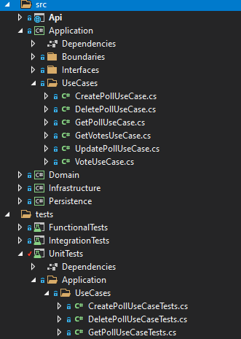
Organization of your tests
Testcase Class per Class
Testcase Class per Method
Testcase Class per Feature
Testcase Class per Fixture

Slide 13
Naming Conventions
Naming your tests
Unit Tests should clearly explain what behavior they’re testing
The name of your test should consist of three parts:
The name of the method being tested.
The scenario under which it's being tested.
The expected behavior when the scenario is invoked.
Use `SUT` for the object we exercise in the test
The "system under test“, it is short for "whatever thing we are testing"

Slide 14
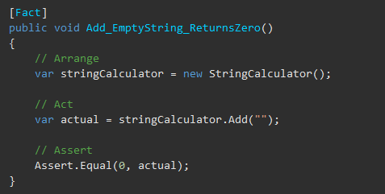

Arranging your tests
Arrange, Act, Assert is a common pattern when unit testing.
Arrange your objects, creating and setting them up, as necessary.
Act on an object.
Assert that something is as expected.
Avoid writing the assert line and the method call in the same statement

Slide 15
Best practices: Fixture Management

Slide 16
What is Fixture Management?
The test fixture is everything we need to have in place to exercise the SUT
Typically, it includes at least an instance of the class whose method we are testing
It may also include other objects on which the SUT depends

Slide 17
Building Fixture: Implicit Setup
Framework calls a special “SetUp” method
Runs before every Test Method/Testcase Class

Slide 18
Building Fixture: Implicit Setup (2)
Pros
Code reusability
Automatically executed
Cons
Tests are more difficult to understand
Test fixture can easily become unreadable
All test methods need to be able to use the fixture it creates

Slide 19
Building Fixture: In-line Setup
Аll fixture setup logic is contained within the Test Method
Мain drawback of In-line Setup is that it tends to lead to Test Code Duplication
Test Methods need to perform similar fixture setup
This Test Code Duplication leads, in turn, to High Test Maintenance Cost

Slide 20
Building Fixture: Delegated Setup
To reduce Test Code Duplication, we can refactor our Test Methods to use Delegated Setup
Use Creation Methods for creating object on which our test depends
They allow both the test reader and the test automater to focus on what is being created without being distracted by how it is created.
Creation Methods can be kept as private methods on the Testcase Class or moved to a Test Helper
Moto: When it is not important for something to be seen in the test method, it is important that it not be seen in the test method!

Slide 21
Fluent builder pattern
Extract the object construction code out and put it in a separate object which we call a builder
Advantages:
Increase the readability and the simplicity of tests
More maintainable code
Reduce errors during the creation of an object

Slide 22
Recap: Fixture Management
The test fixture is everything we need to have in place to exercise the SUT
Use implicit setup only if you follow Testclass per Fixture organization
In-line setup provides better readability, but can lead to Code Duplication
To reduce Test Code Duplication, use Delegated Setup with Creation Methods
Consider implementing Fluent builder pattern

Slide 23
Test Doubles
Component that we install in place of the real component
Depending on the reason why we are using it, a Test Double can behave in different ways
Most common types:
Mock: test double object that decides whether a unit test has passed or failed
Stub: controllable replacement for an existing dependency
The term mock is unfortunately often misused when talking about testing.
All types:
Dummy, Fake Object, Stub, Mock Object, Spy

Slide 24
Result Verification
Testing only one concert
Avoid multiple asserts
Avoid writing your own custom assert messages
Avoid using `ExpectedException` attribute

Slide 25
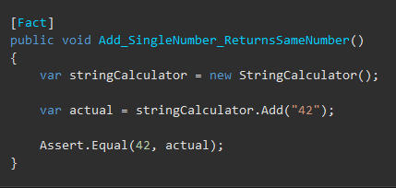
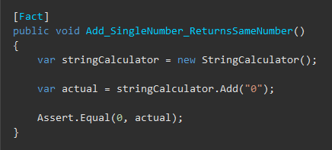
Write minimally passing tests
The input should be the simplest possible
Setting extra properties on models or using non-zero values when not required, only detracts from what you are trying to prove.
Bad: Better:

Slide 26
Avoid testing private or protected methods
Private or protected methods are usually private for a good reason
Private methods are an implementation detail
Internal contracts are dynamic, and they can change when you refactor the system.
The public contract (the overall functionality) is all that you need to care about
If a private method is worth testing, it might be worth making it public

Slide 27
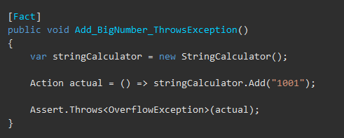
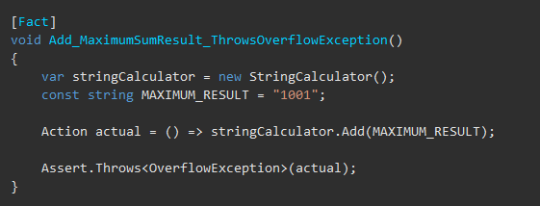
Avoid magic strings
Bad: Better:

Slide 28
Other good practices
Avoid logic in tests (if, while, for, switch, etc.)
Stub static references (for example, DateTime.Now)

Slide 29
Recap: DEMO

Slide 30

Code Coverage
Code coverage represents the amount of code that is covered by unit tests.
A high code coverage percentage is often associated with a higher quality of code
A high code coverage percentage is not an indicator of success

Slide 31
Resources
XUnit Test Patterns
Test Pyramid and Practical Test Pyramid
Why Did we Build xUnit 1.0?
Why you should not use SetUp and TearDown in Nunit
Fluent builder pattern and ObjectMother
Unit testing best practices with .NET Core and .NET Standard
Mocks, Fakes, Stubs and Dummies
TestDouble

Slide 32

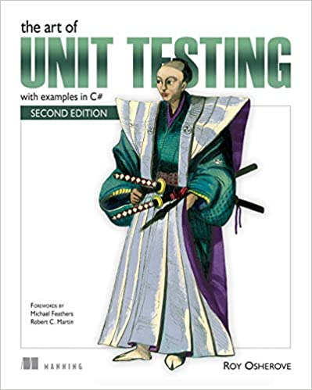
Recommended books
xUnit Test Patterns: Refactoring Test Code
by Gerard Meszaros
The Art of Unit Testing: with examples in C#
by Roy Osherove

Slide 33
Questions
Slides and demo project:
http://bit.ly/devbg-april-dotnet

Slide 34
Thank you!
Контакти:
dermendzhiev.n@gmail.com
https://www.linkedin.com/in/nikolay-dermendzhiev/
Следващо събитие:
Data Integration in Microsoft Azure

